Slide 1
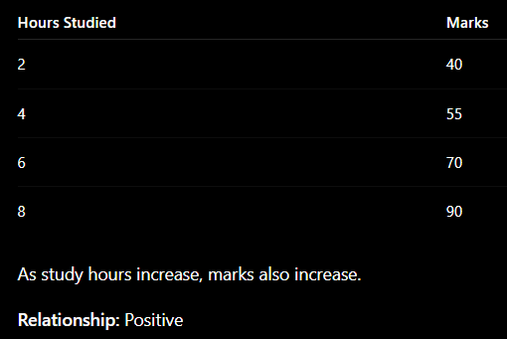
UNIT – IV
Relationships Between Two Variables
Definition
Relationship between two variables means how one variable changes when another variable changes.
If one increases and the other also increases → Positive relationship
If one increases and the other decreases → Negative relationship
If there is no pattern → No relationship

Slide 2
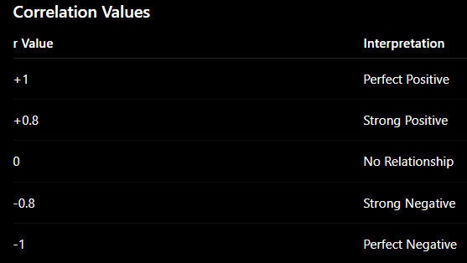
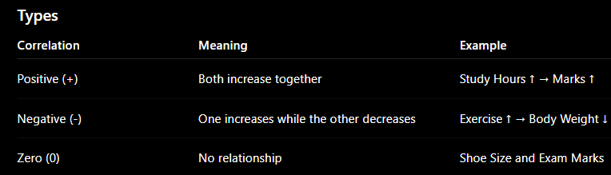
Key Concepts
1. Correlation
Definition
Correlation measures the strength and direction of the relationship between two numerical variables.

Slide 3
2. Causation
Definition
Causation means one variable directly causes changes in another variable.
Example
More Fertilizer → Better Crop Yield
Here fertilizer directly affects crop growth.
Important Point
Correlation does not always mean causation.
Example:
Ice Cream Sales ↑ and Drowning Cases ↑
Both increase during summer, but ice cream does not cause drowning.

Slide 4
3. Association
Definition
Association means two variables are related, but one may not necessarily cause the other.
Example
Umbrella Sales ↑ and Rainfall ↑
Rain increases umbrella sales.
There is an association.
4. Independence
Definition
Two variables are independent if one variable does not affect the other.
Example
Student Roll Number and Height
These variables have no relationship.

Slide 5
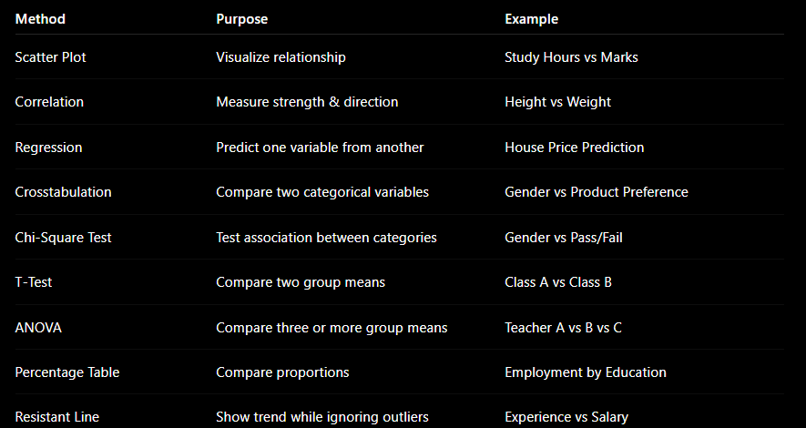

Slide 6
Percentage Tables in Bivariate Analysis Percentage tables (also known as proportion tables or relative frequency tables) are used to understand the distribution and relationship between two categorical variables.
They provide a clear and concise way to visualize the proportion of observations in each category combination of the two variables.
These tables help in identifying patterns, associations, and potential dependencies between the variables.
Key Concepts
Frequency Table: A table that displays the count of occurrences for each combination of categories in two categorical variables.
Percentage Table: A table that converts the counts from a frequency table into percentages, making it easier to interpret the proportions.
Row Percentage Table: Shows the percentage of each row category within the corresponding column categories.
Column Percentage Table: Shows the percentage of each column category within the corresponding row categories.
Overall Percentage Table: Shows the percentage of each cell relative to the total number of observations.

Slide 7
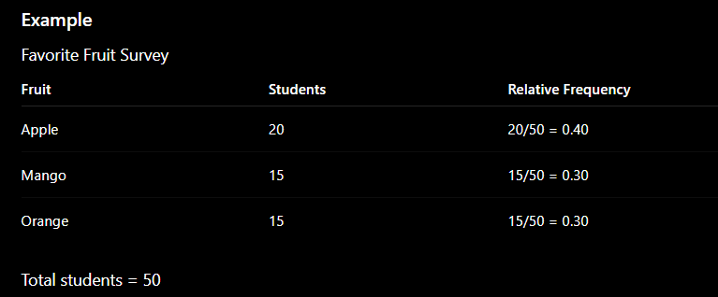
Relative Frequency Distribution
Definition
Relative frequency is the proportion of observations in each category.
Formula
Relative Frequency = Frequency / Total Frequency

Slide 8
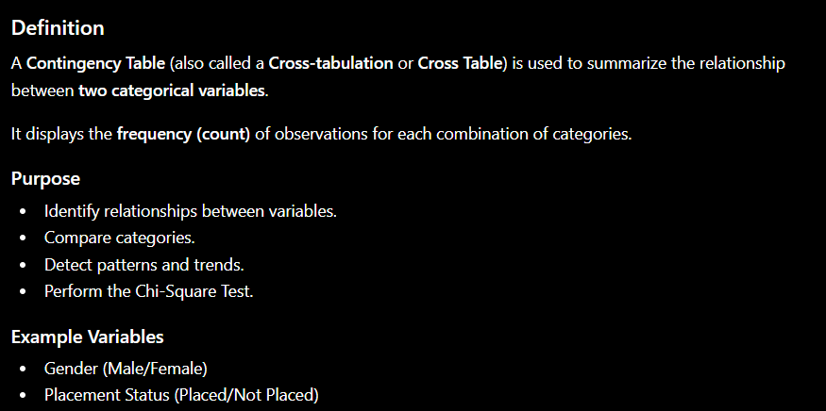

Slide 9
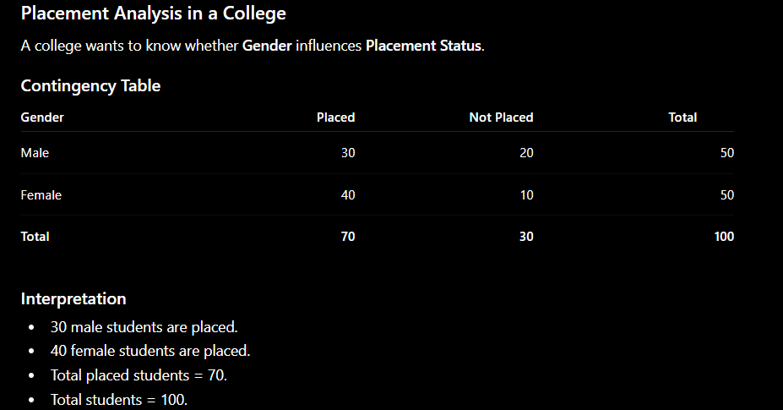

Slide 10
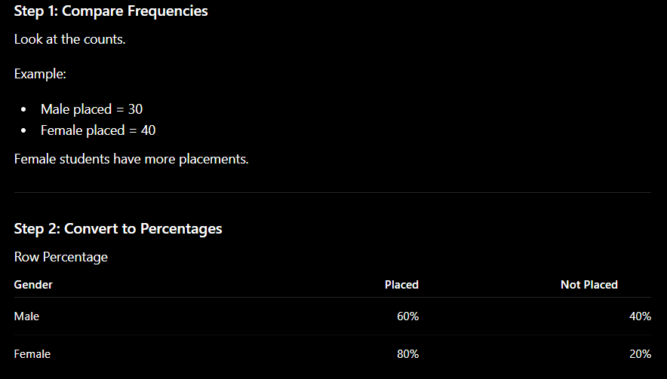

Slide 11
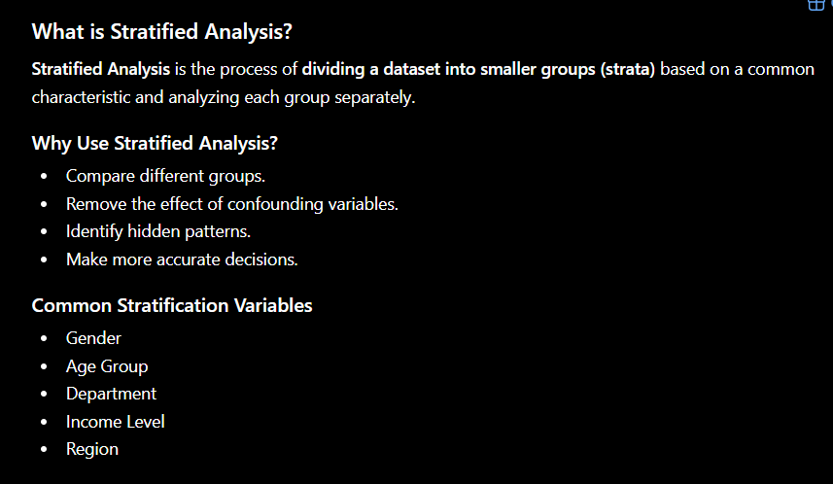

Slide 12
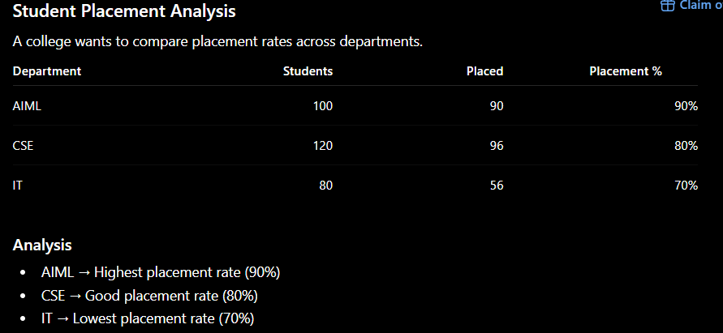

Slide 13
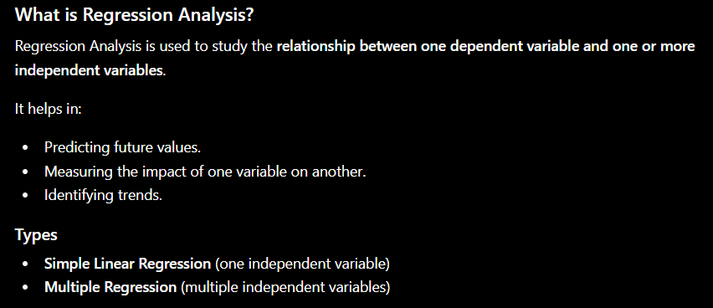

Slide 14
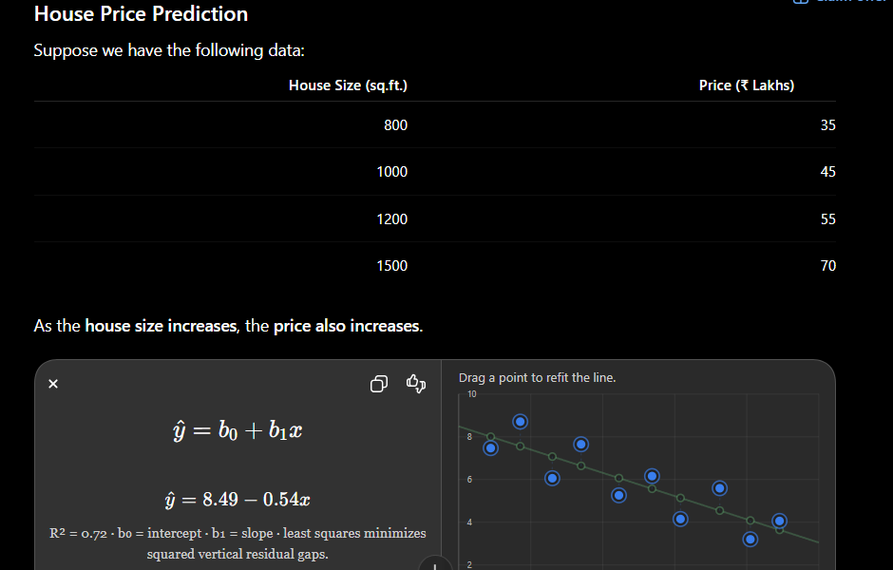
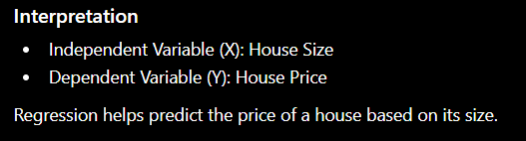

Slide 15
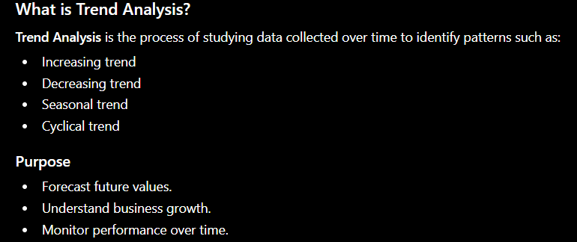

Slide 16
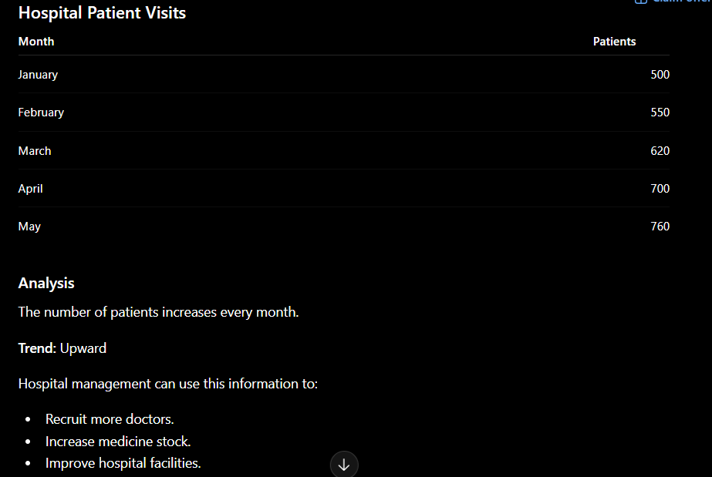

Slide 17
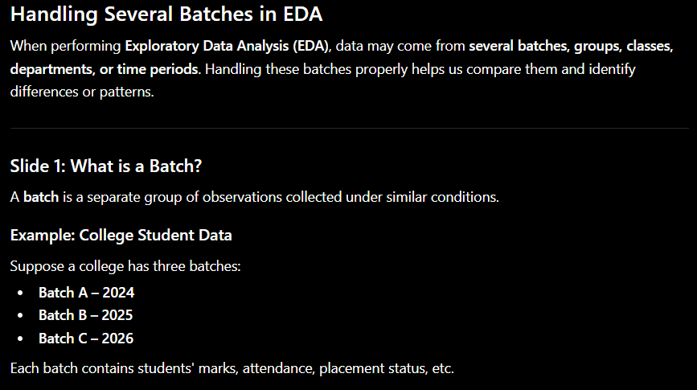

Slide 18
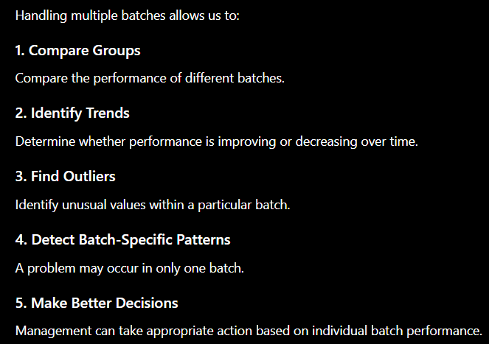
Why Handle Several Batches?

Slide 19
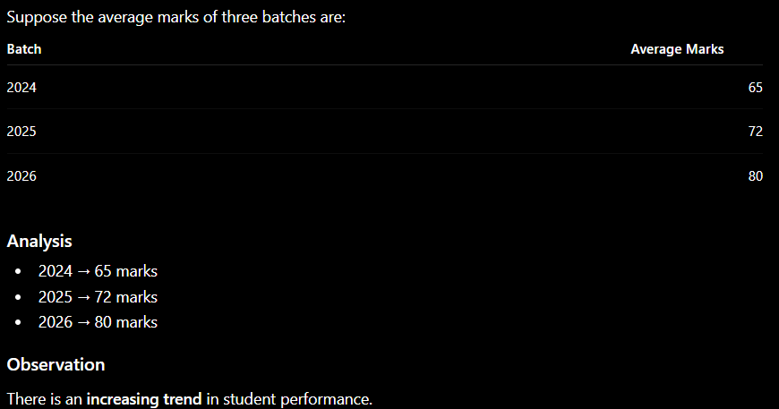
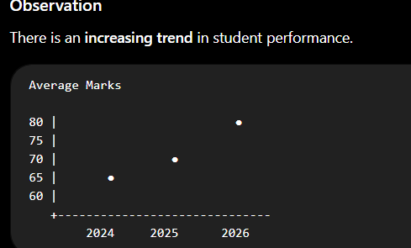

Slide 20
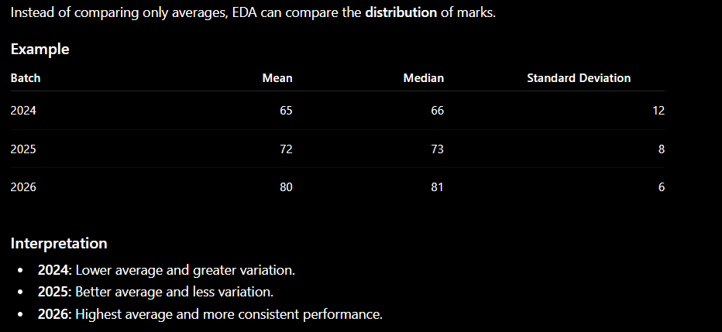
Compare Distribution Across Batches

Slide 21
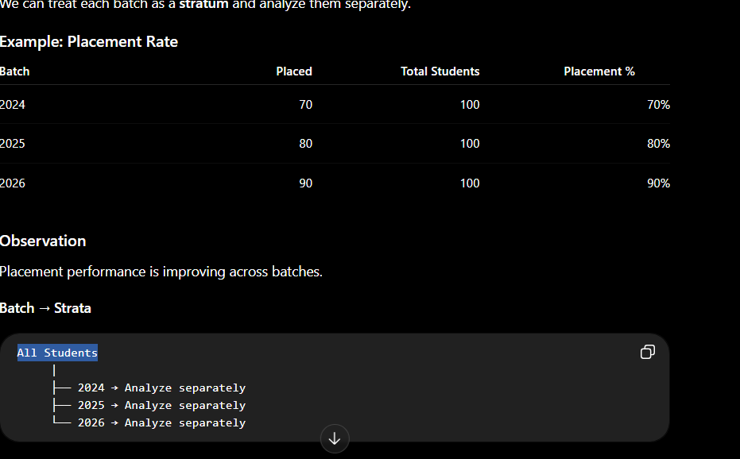
Handling Several Batches Using Stratified Analysis

Slide 22
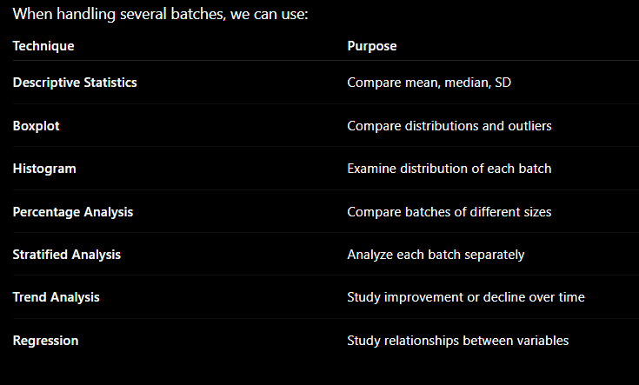
Key EDA Techniques for Multiple Batches

Slide 23
Resistant Lines in EDA
1. What is a Resistant Line?
A resistant line is a regression line designed to show the central trend of the data without being strongly affected by extreme values (outliers).
It is also called a robust regression line.
Simple Meaning
A resistant line tries to represent the majority of the data, rather than allowing a few unusual observations to pull the line toward them.

Slide 24
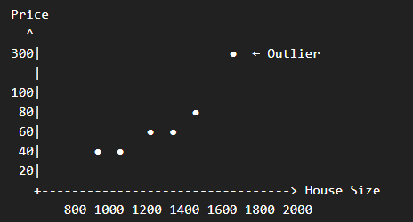
Why Do We Need Resistant Lines?
Consider a dataset showing:
House Size vs House Price
Most houses follow a normal pattern:
Small house → Lower price
Large house → Higher price
But suppose one luxury house has an extremely high price.
A traditional least-squares regression line can be pulled toward this unusual house.
A resistant line reduces the influence of that outlier.

Slide 25
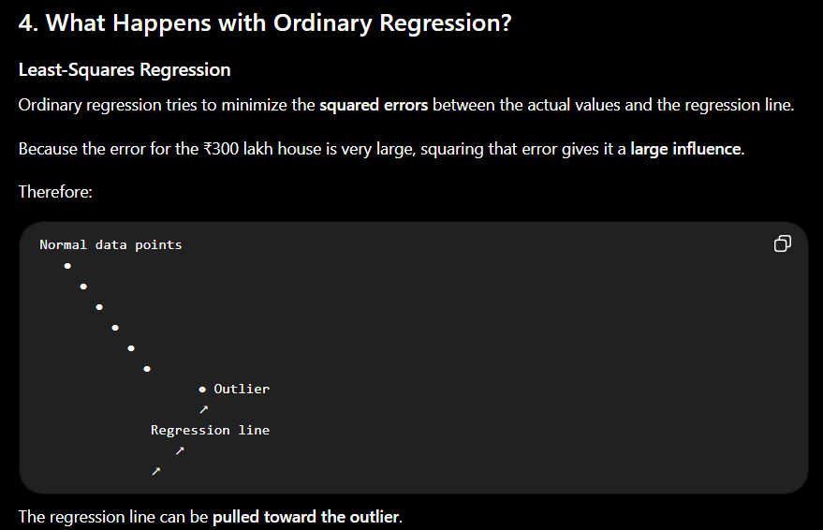

Slide 26
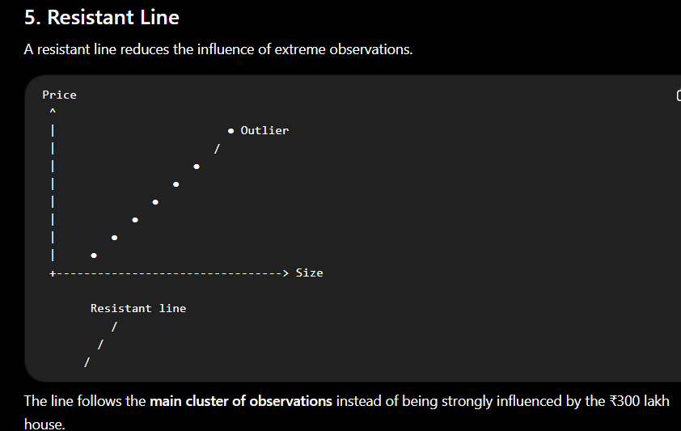

Slide 27
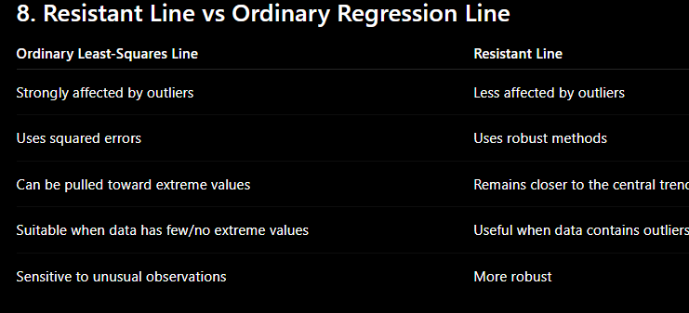

Slide 28
Feature Selection and Importance Scores in EDA
Feature Selection and Feature Importance are important techniques used to identify which variables are useful for predicting a target variable.
What is Feature Selection?
Feature Selection is the process of selecting a subset of relevant features (variables) from a dataset for building a predictive model.
Why Do We Need Feature Selection?
1. Improve Model Accuracy
Irrelevant features can introduce noise.
Removing them allows the model to focus on useful information.
Example:
If predicting exam results, Study Hours is likely useful, while Favorite Color is unlikely to help.

Slide 29
2. Reduce Computational Cost
Fewer features mean:
Less data processing
Faster model training
Less memory usage
Example
Instead of processing 100 features, we may select only the 20 most useful features.
3. Reduce Overfitting
If a model uses too many irrelevant features, it may learn unnecessary patterns from the training data.
Removing irrelevant or redundant features can help the model generalize better to new data.

Slide 30
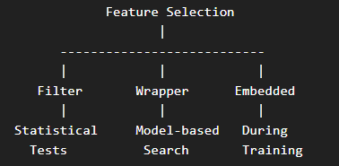
Methods of Feature Selection
There are three major approaches:
1. Filter Methods
2. Wrapper Methods
3. Embedded Methods
Filter Methods
Filter methods select features using statistical measures, without training a machine learning model for every feature subset.
Examples
Chi-Square Test
ANOVA F-Test
Correlation
Mutual Information

Slide 31
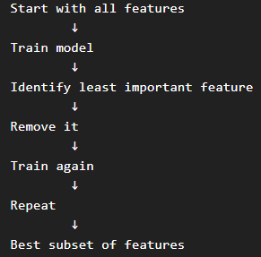
Wrapper Methods
Definition
Wrapper methods use a machine learning model to evaluate different combinations of features.
One important method is:
Recursive Feature Elimination (RFE)
RFE works approximately like this:
Key Point
Wrapper = Use a model to find the best feature subset.

Slide 32
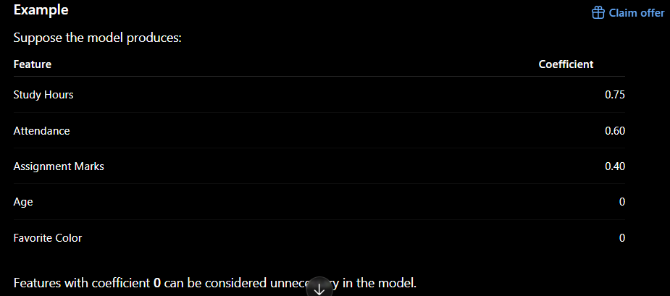
Embedded Methods
In Embedded Methods, feature selection happens during the model training process.
Example: Lasso Regression
Lasso uses L1 regularization.
It can shrink some feature coefficients to zero.
Key Point
Embedded = Feature selection happens while the model is being trained.

Slide 33
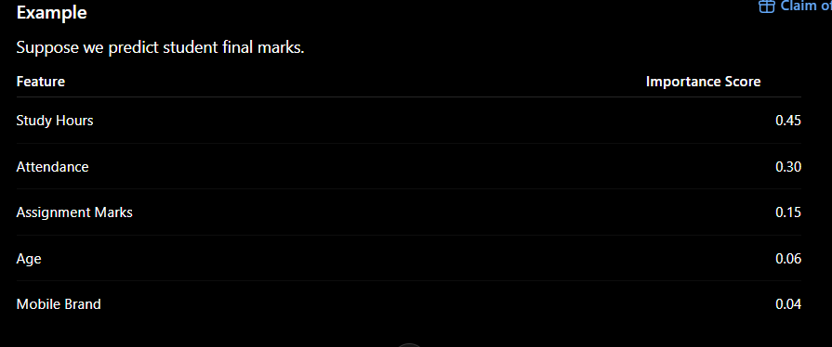
What are Feature Importance Scores?
Feature Importance Score indicates how useful or influential a feature is in making predictions.
Many machine learning models can calculate feature importance.
Examples
Random Forest
Gradient Boosting
Decision Trees

Slide 34
Summary
Feature Selection
Select the most relevant features and remove unnecessary ones.
Three Methods
Filter → Statistical tests
Wrapper → Model-based feature selection
Embedded → Selection during model training
Feature Importance
Measures how much each feature contributes to model predictions.
Easy Way to Remember
Filter → Test
Wrapper → Try different subsets
Embedded → Select while learning
Importance Score → Rank the features

